Slide 1
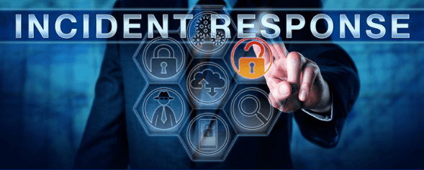
Maven Clinic – Suspicious Activity
Cyber Security Incident Response Plan & Review

Slide 2
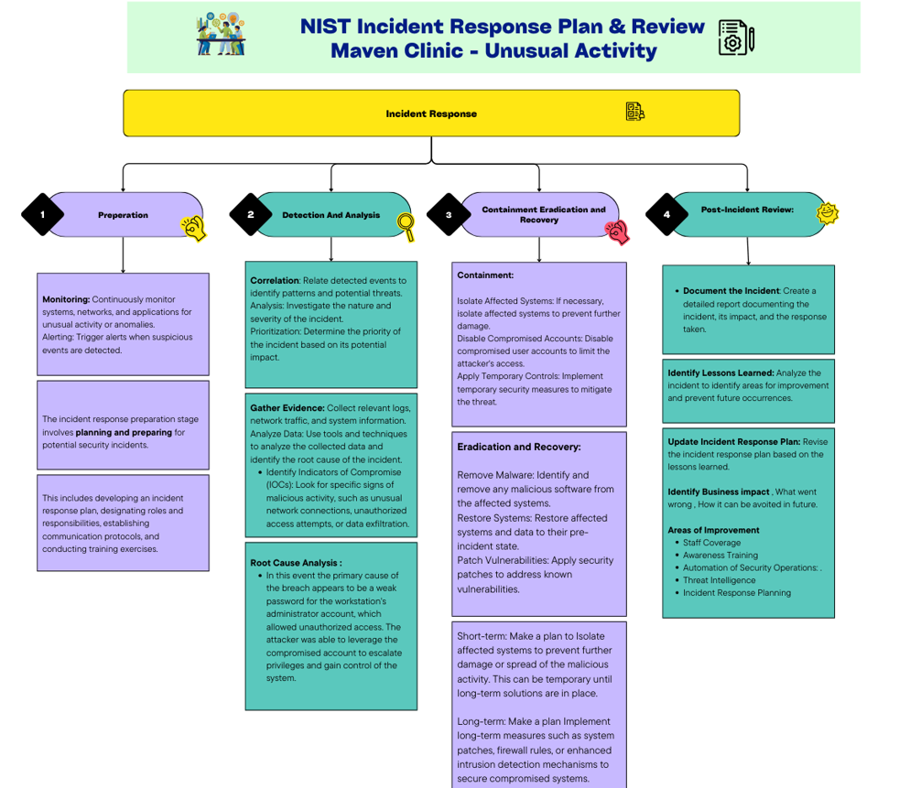

Slide 3
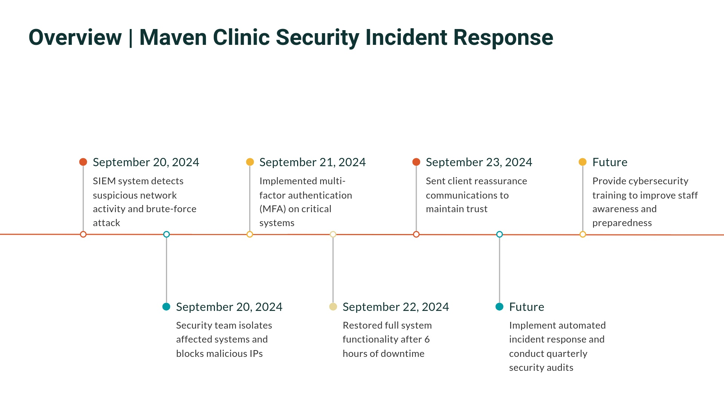

Slide 4
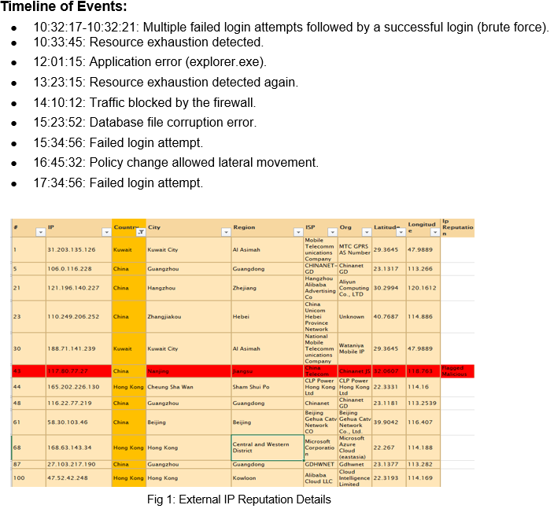

Slide 5
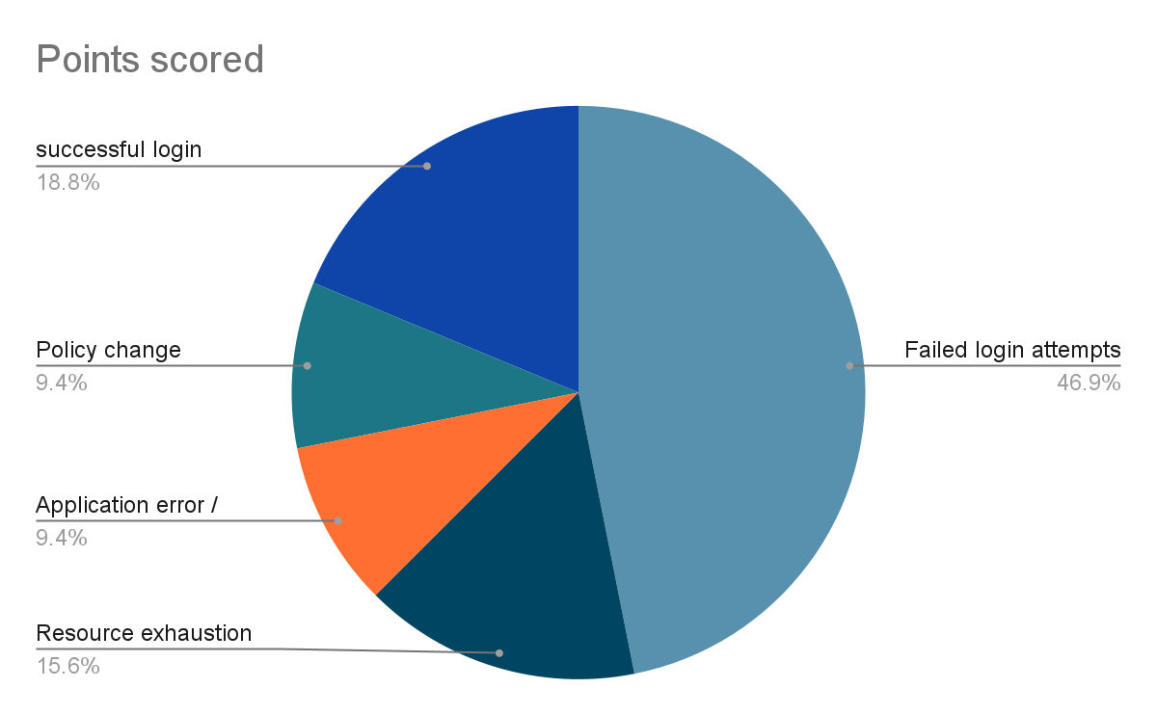
Root Cause Analysis
The primary cause of the breach appears to be a weak password for the workstation's administrator account, which allowed unauthorized access. The attacker was able to leverage the compromised account to escalate privileges and gain control of the system.
On September 20, 2024, Maven Clinic Security Team detected suspicious network activity, including a traffic spike to the external IP address 203.0.113.45 and Multiple failed SSH and RDP login attempts. The activity indicated a brute-force attack targeting sensitive systems and prompted immediate escalation to the security team.
Upon investigation, an unauthorized user account was found accessing sensitive files outside of business hours.
Pie chart displays Event and its occurrence Percentage .

Slide 6
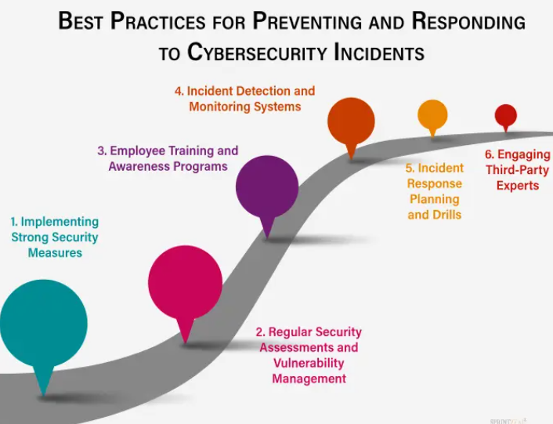
Security Review

Slide 7
Response to Affected Customers and Stakeholders
When a healthcare organization experiences a data breach, it's crucial to respond promptly, transparently, and empathetically to affected customers.
1. Rapid Assessment and Containment: Quickly determine the scope and severity of the breach and Implement measures to prevent further data loss.
2. Notification and Communication: Contact affected individuals as soon as possible, providing clear and concise information
3. Empathy and Support: Express empathy for the inconvenience and potential distress caused by the breach. Offer support like credit monitoring/financial settlement etc.,
4. Communication and Updates: Provide regular updates to affected individuals and stakeholders about the progress of the investigation and remediation efforts. Be responsive to their questions and concerns.

Slide 8
Containment Eradication & Recovery
The goal of containment is to stop the attack before it overwhelms resources or causes damage and bring back the system to normal business operations.
Short-term: Make a plan to Isolate affected systems to prevent further damage or spread of the malicious activity. This can be temporary until long-term solutions are in place
Long-term: Make a plan Implement long-term measures such as system patches, firewall rules, or enhanced intrusion detection mechanisms to secure compromised systems.

Slide 9
Recommended Actions
Implement strong password policies and multi-factor authentication.
Conduct regular security assessments and vulnerability scans.
Provide security awareness training to employees.
Develop and test a comprehensive incident response plan.
Invest in automated security tools to streamline incident response and improve efficiency.
Stay informed about emerging threats and trends through threat intelligence feeds.

Slide 10
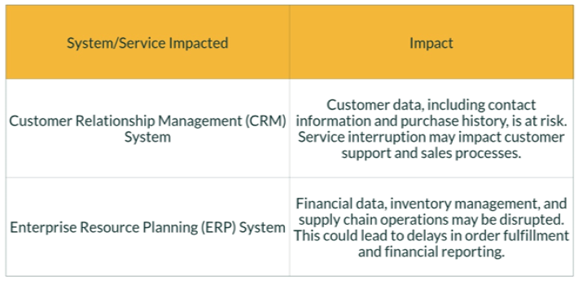
Post Incident Review
Impact to organization

Slide 11
Impact | Effect
Data Exfiltration | Sensitive patient data stored on the workstation may have been compromised.
Disruption of Services | The compromised workstation may have affected the availability of critical services.
Reputational Damage: | A data breach could damage Maven Clinic's reputation and public trust.
Regulation compliance | HIPAA and GDPR must be focused and take steps if any customer data that may have been exposed or compromised.
Downtime | operational disruption or unavailability of data
Customer Impact | Take necessary actions if any sensitive data or PII /health related data exposed

Slide 12
Communication Plan
Key Stakeholders:
Stakeholders and the team must be quickly notified about the incident.
IT Department: All members of the IT team, including system administrator, network engineers must be notified and take necessary steps to closely monitor the network.
Executives: C-level executives, board members, and other key decision-makers.
Affected Users: Employees, customers, or partners who may be impacted by the incident. This case Host machine DESKTOP-1234567 and user John doe must be notified , the file or server owner must be informed about the incident.
External Parties: Law enforcement, regulatory agencies, or other third parties as needed. Incase of data breach of sensitive information that involves other parties must be communicated directly.

Slide 13
Lessons Learned
Importance of Strong Passwords: The breach highlights the critical importance of using strong, unique passwords for all accounts.
Regular Security Assessments: Regular vulnerability assessments are essential for identifying and addressing potential risks.
Employee Education: Security awareness training can help employees recognize and prevent phishing attacks.
Incident Response Planning: A well-defined incident response plan can help organizations respond effectively to security incidents.
Conduct a Post-Incident Review: Analyze the incident to identify lessons learned and areas for improvement.
Implement Preventive Measures: Strengthen security measures to prevent similar incidents in the future

Slide 14
Preventive Measures
Phishing Awareness Training
Strong Password Policies( complex with MFA)
Regular Security Assessments
Incident Response Planning
Data Encryption
Strong Access Controls to limit sensitive data access
Third-Party Risk Management

Slide 15
Areas of Improvement
Staff Coverage: Ensure adequate staffing levels within the security operations center (SOC) to maintain 24/7 coverage and timely response to incidents.
Awareness Training: Provide regular security awareness training to employees to help them recognize and prevent phishing attacks and other social engineering tactics.
Automation of Security Operations: Implement automated security tools like SOAR , XDR, ASO (Autonomic SecOps) etc., and processes to reduce the burden on security teams and improve response times.
Threat Intelligence: Leverage threat intelligence feeds to stay informed about emerging threats and trends.
Incident Response Planning: Develop and regularly test a comprehensive incident response plan to ensure a coordinated and effective response to security incidents.
Implement ZTA , Strong MFA and system Hardening measures.

Slide 16
Conclusion
By addressing these Lesson learned areas and implementing the recommended measures, Maven Clinic can significantly enhance/strengthen its security posture and reduce the risk of future breaches. Regular review and updates of the incident response plan are essential to maintain a proactive and effective approach to cybersecurity.

